Slide 1

Lesson 3: Introduction to Flutter
TMA3084 - Software Engineering Laboratory
Lab Demo: MD. Aminul Islam Rakib
Lecturer: Madam Nurfauza Binti Jali
Page

Slide 2
Table of contents
01
Understanding Flutter
02
Flutter Framework and Installing and Configuring Flutter SDK
03
Android Studio
04
Setup an Android Device
05
Run your Apps on a Hardware Device (Physical Phone)
06
Introduction to Flutter Widgets
07
What is a MaterialApp widget?
Page

Slide 3
1. Understanding Flutter
About Flutter
Flutter is Google’s SDK for creating beautiful and fast apps from a single codebase.
It helps build high-performance apps for iOS, Android, and Web using one set of code.
Before Flutter
iOS apps were built with Objective-C or Swift (Xcode).
Android apps were built with Java or Kotlin.
Companies needed separate teams for iOS and Android.
Developers had to learn multiple languages for both platforms.
With Flutter
You can write once and run anywhere (Android & iOS).
Apps can be published on Google Play and Apple Store.
Saves time, cost, and effort in development.
Works with existing code and is free & open source.
Helps create beautiful, fast, and modern apps easily.
Page

Slide 4
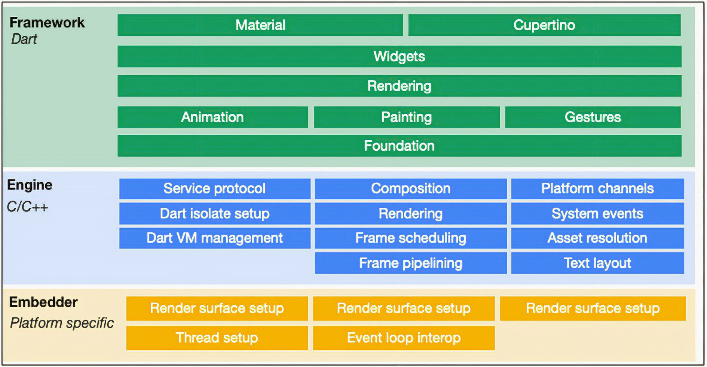
2. Flutter Framework
The Flutter framework is built in multiple layers, where each layer is built upon the one below it. These layers work together to create beautiful, fast, and flexible apps.
Layered Structure
Framework Layer – Contains the widgets, rendering, and animation libraries.
Engine Layer – Written in C++, it provides graphics rendering (Skia), text layout, and low-level APIs.
Embedder Layer – Integrates Flutter into iOS, Android, Web, or Desktop platforms.
Page

Slide 5
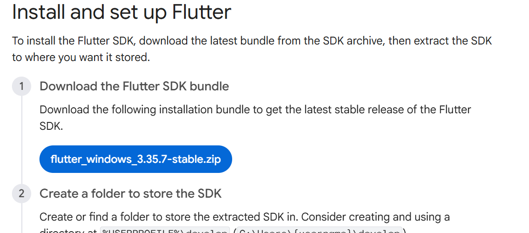
2. Flutter Framework
Install flutter
Click Here: https://docs.flutter.dev/install/manual
Page

Slide 6
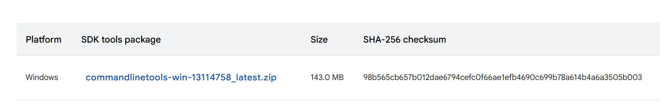
3. Android Studio
Android Studio is the official Integrated Development Environment (IDE) for Android app development, based on IntelliJ IDEA .
Install android studio:
Click this link: https://developer.android.com/studio
Page

Slide 7
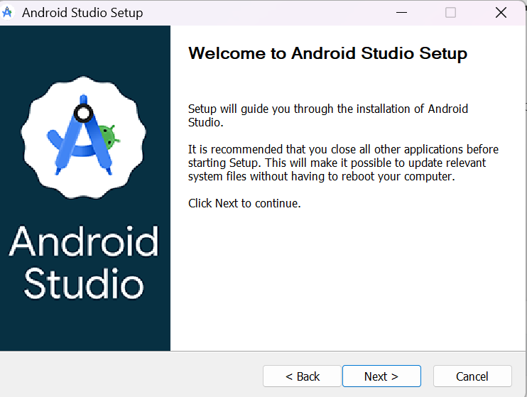
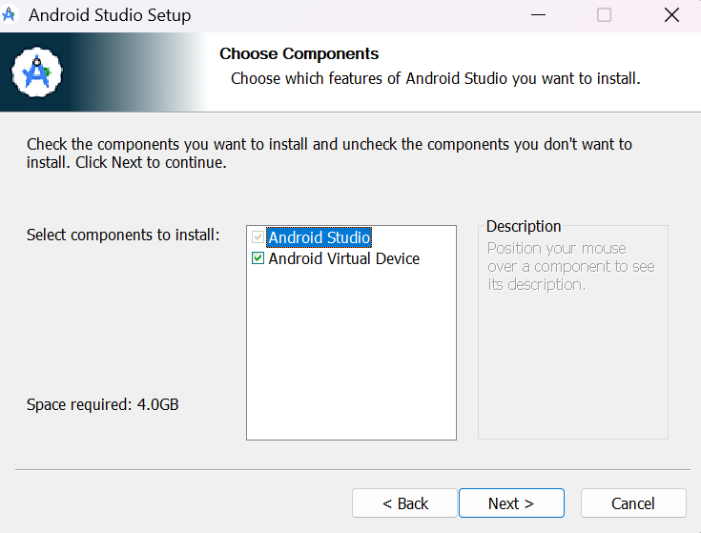
3. Android Studio
Step -1:
Step – 2:
Page

Slide 8
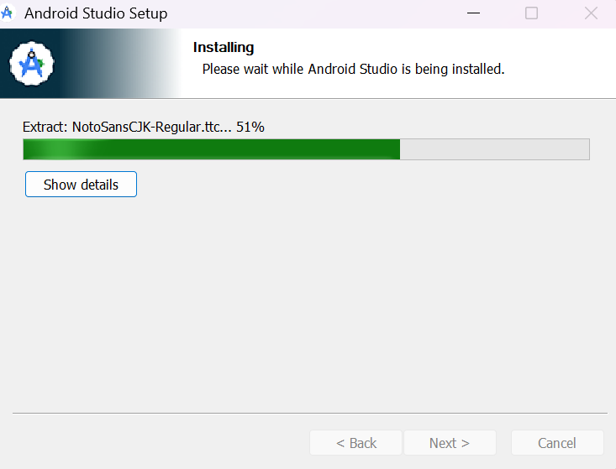
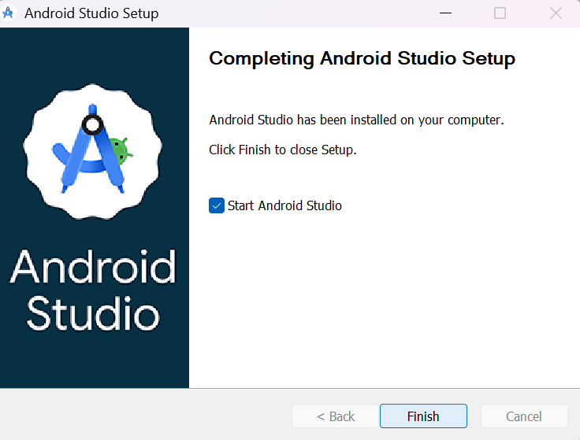
3. Android Studio
Step - 3:
Step – 4:
Page

Slide 9
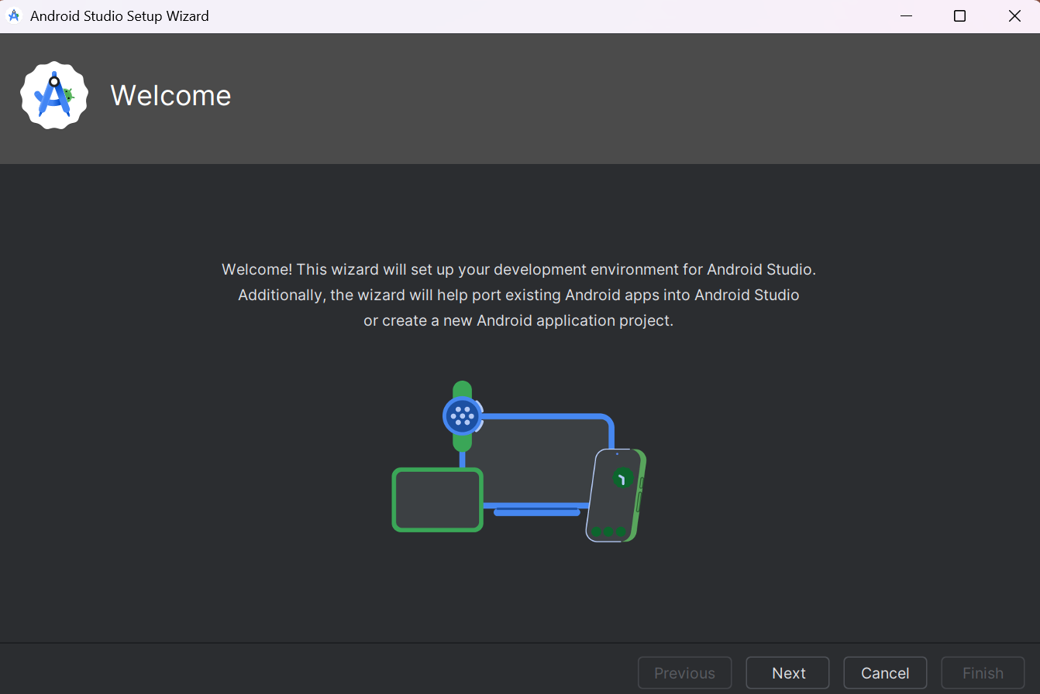
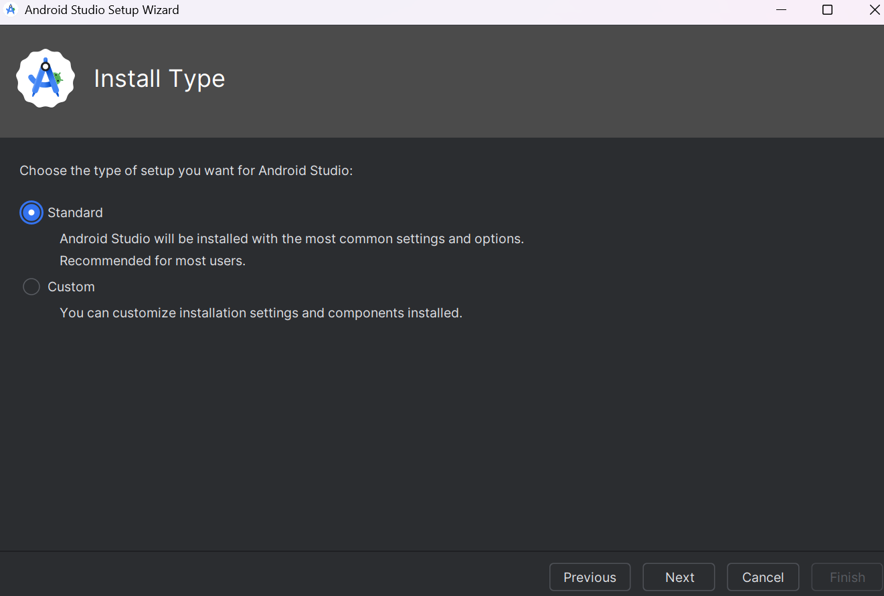
3. Android Studio
Step - 5:
Step - 6:
Page

Slide 10
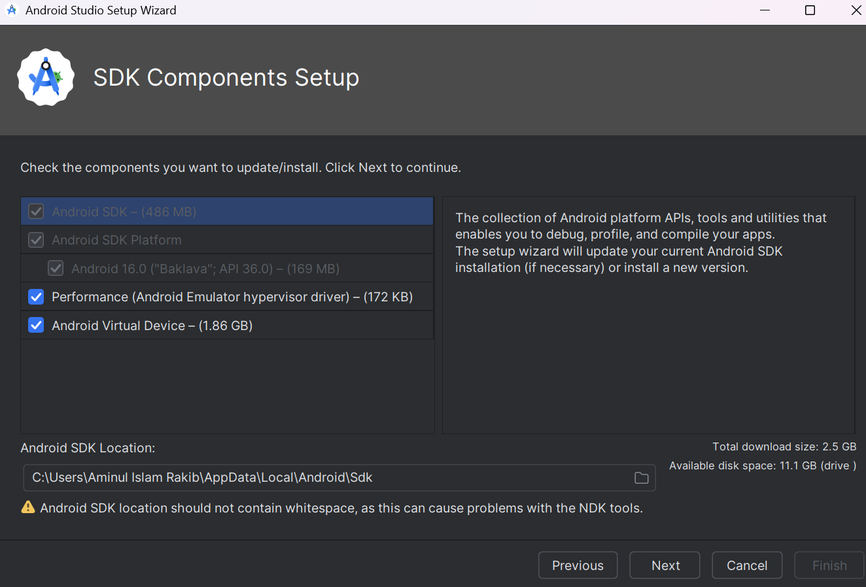
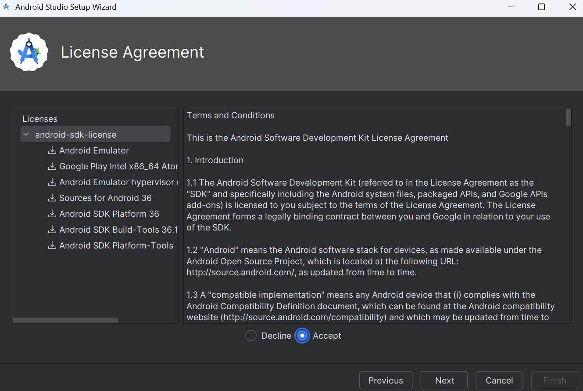
3. Android Studio
Step - 7:
Step - 8:
Page

Slide 11
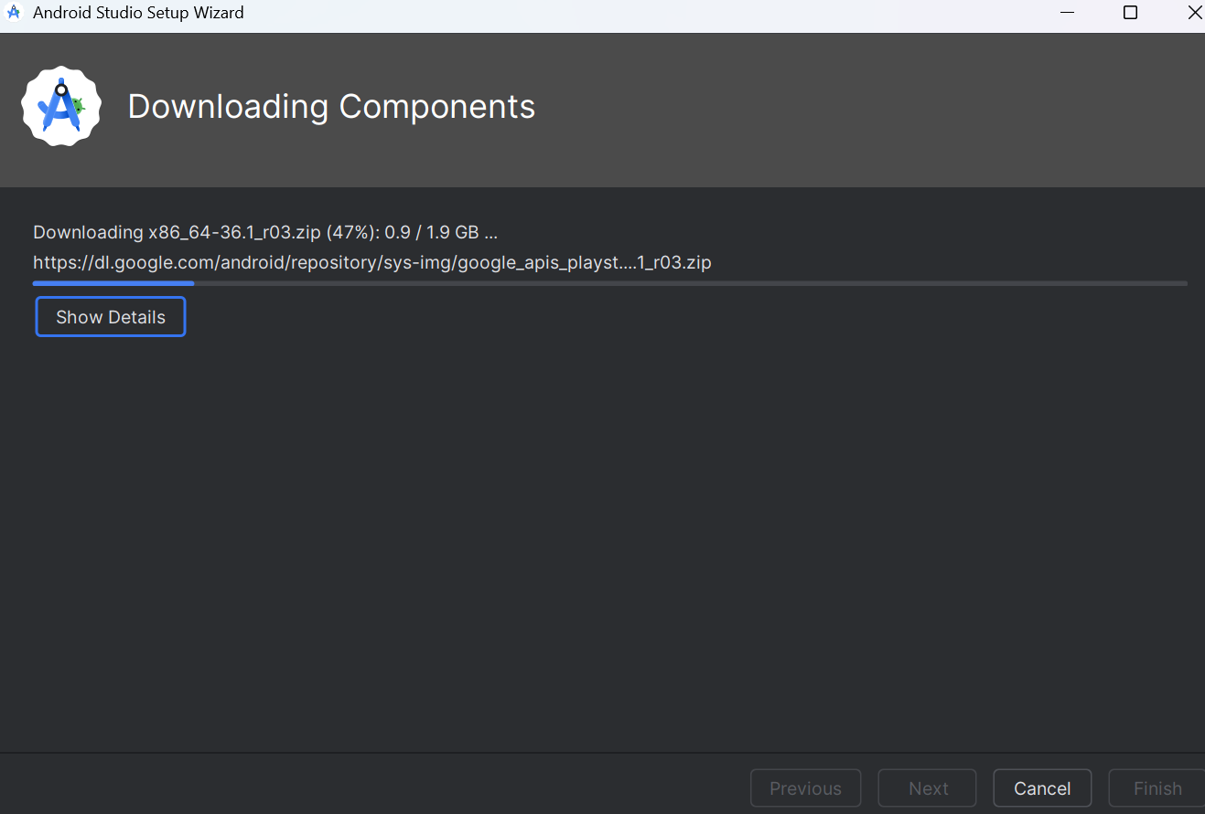
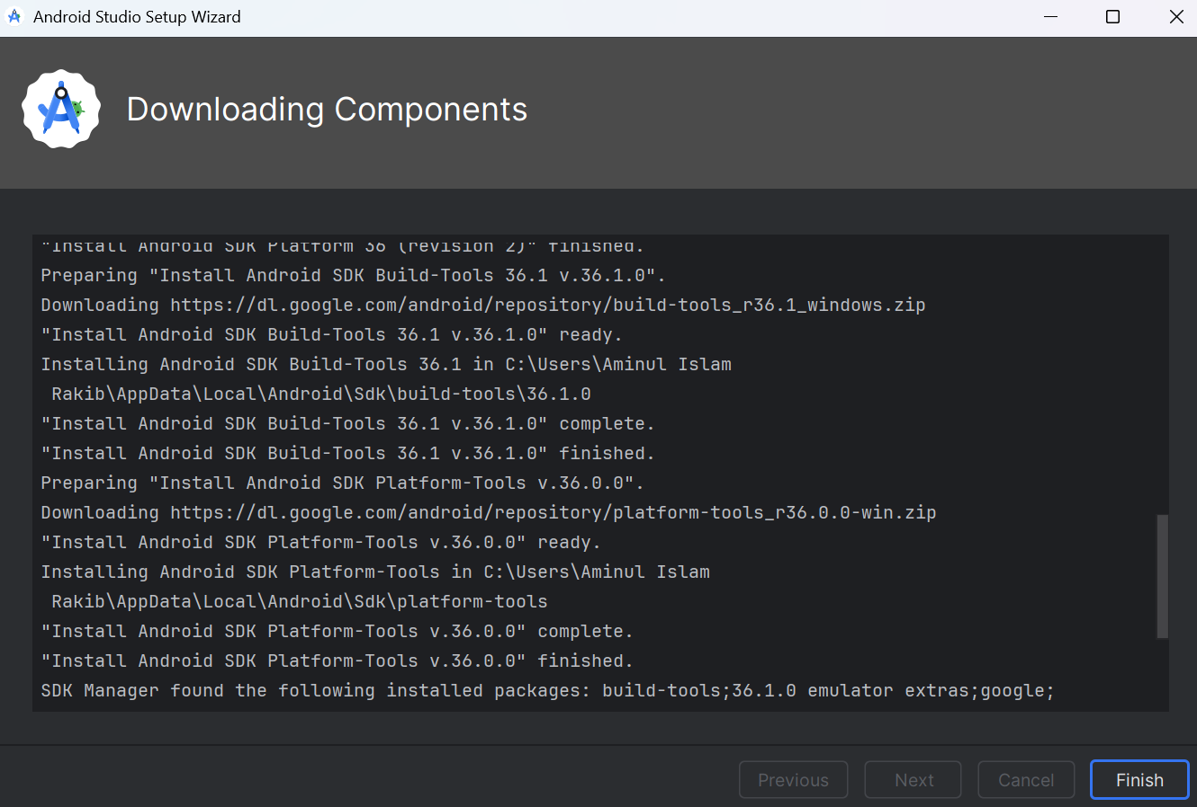
3. Android Studio
Step - 9:
Step - 10:
Page

Slide 12
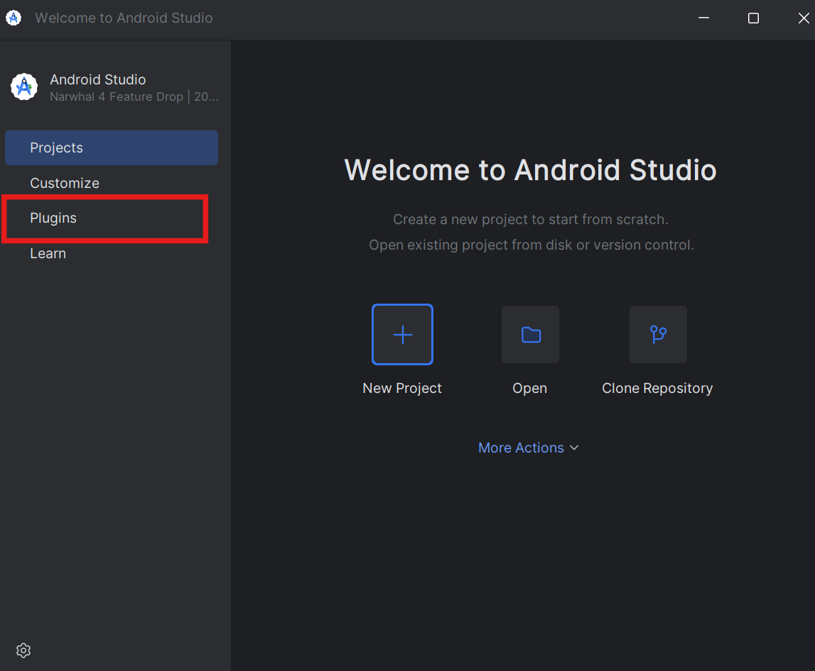
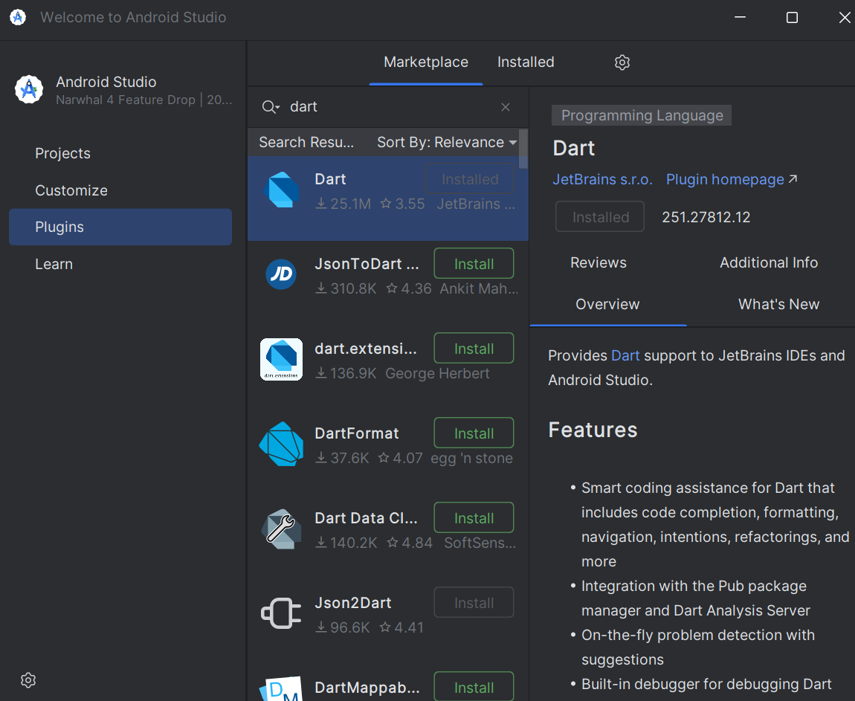
4. Setup an Android Device
Open the android studio
Install dart
Page

Slide 13
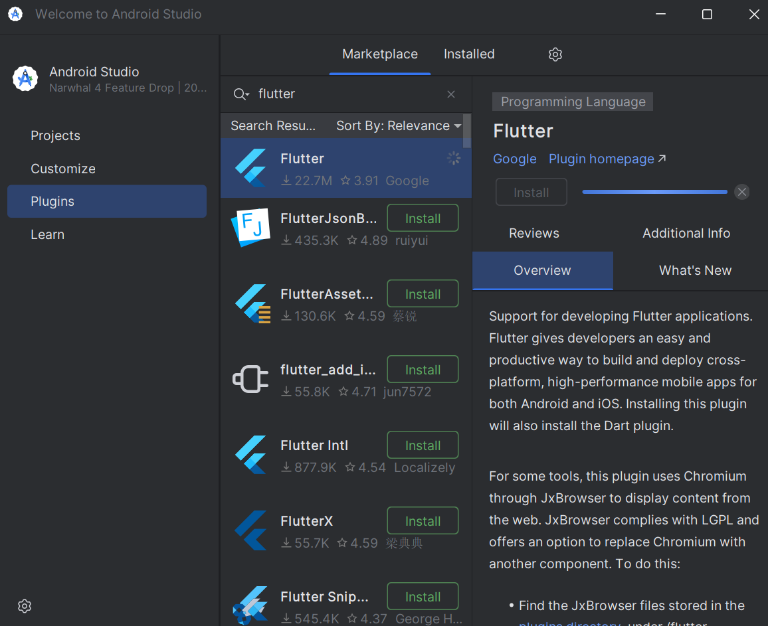
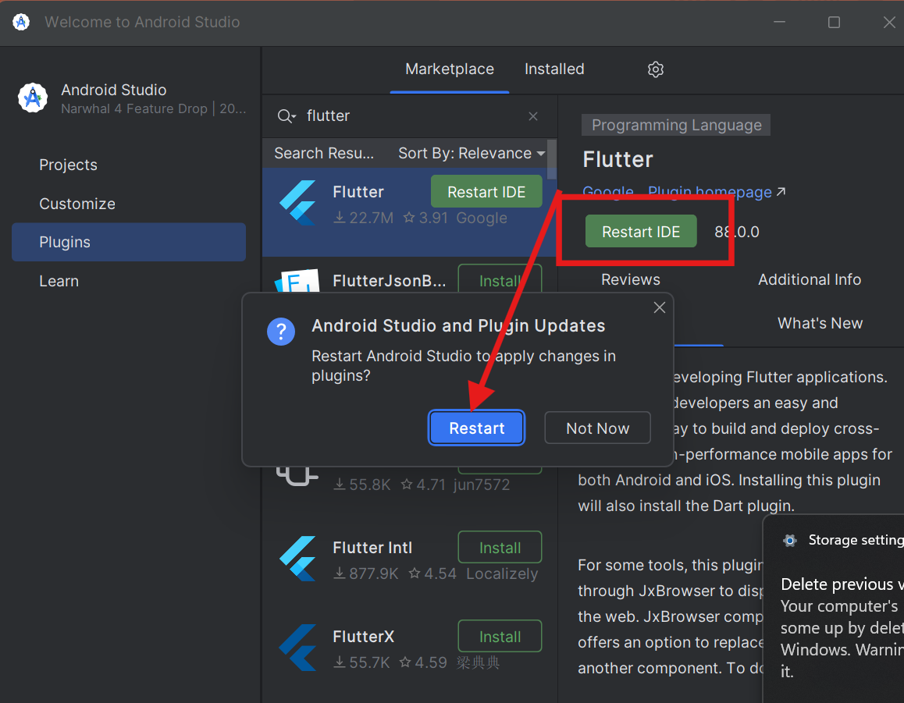
4. Setup an Android Device
Install flutter
Click Restart IDE
Page

Slide 14
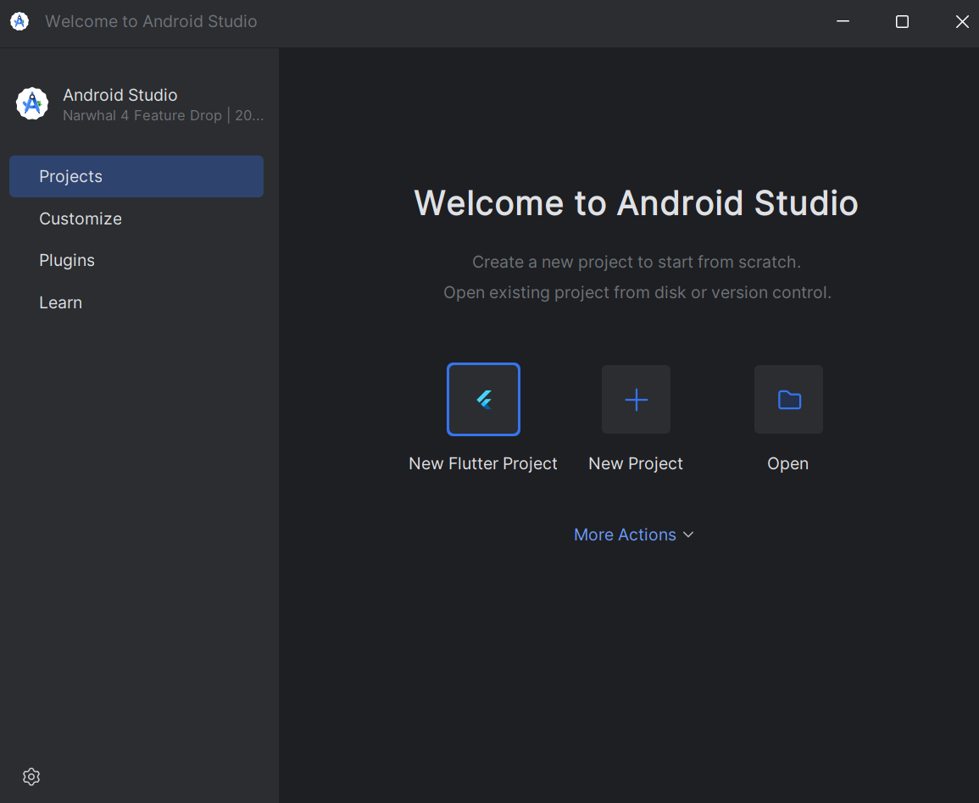
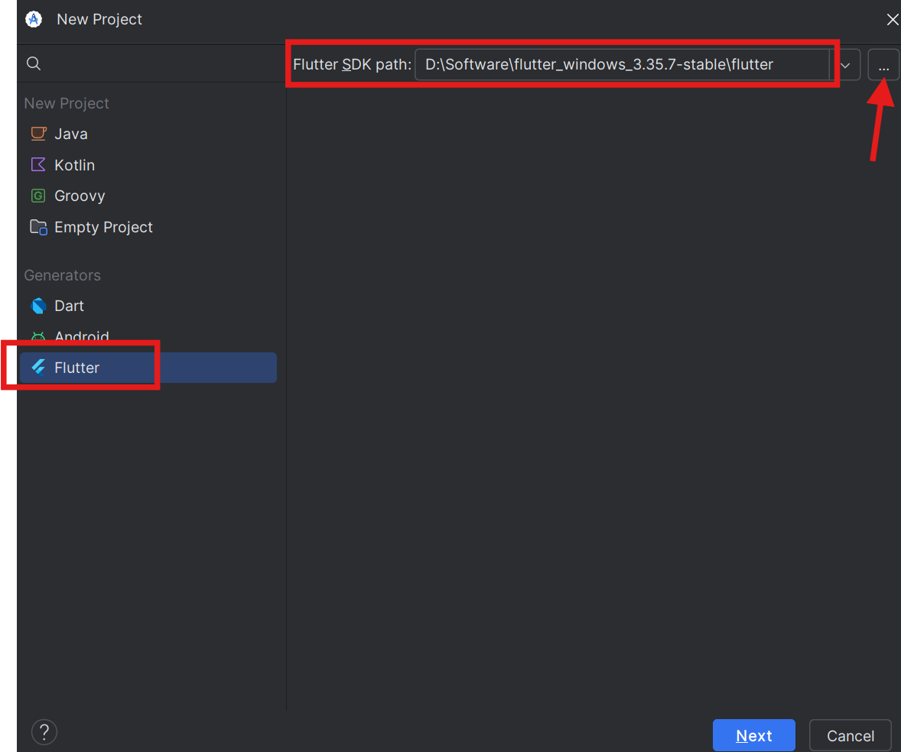
4. Setup an Android Device
Now we found a new option create New Flutter Project.
Chose flutter and set the flutter sdk path
Page

Slide 15
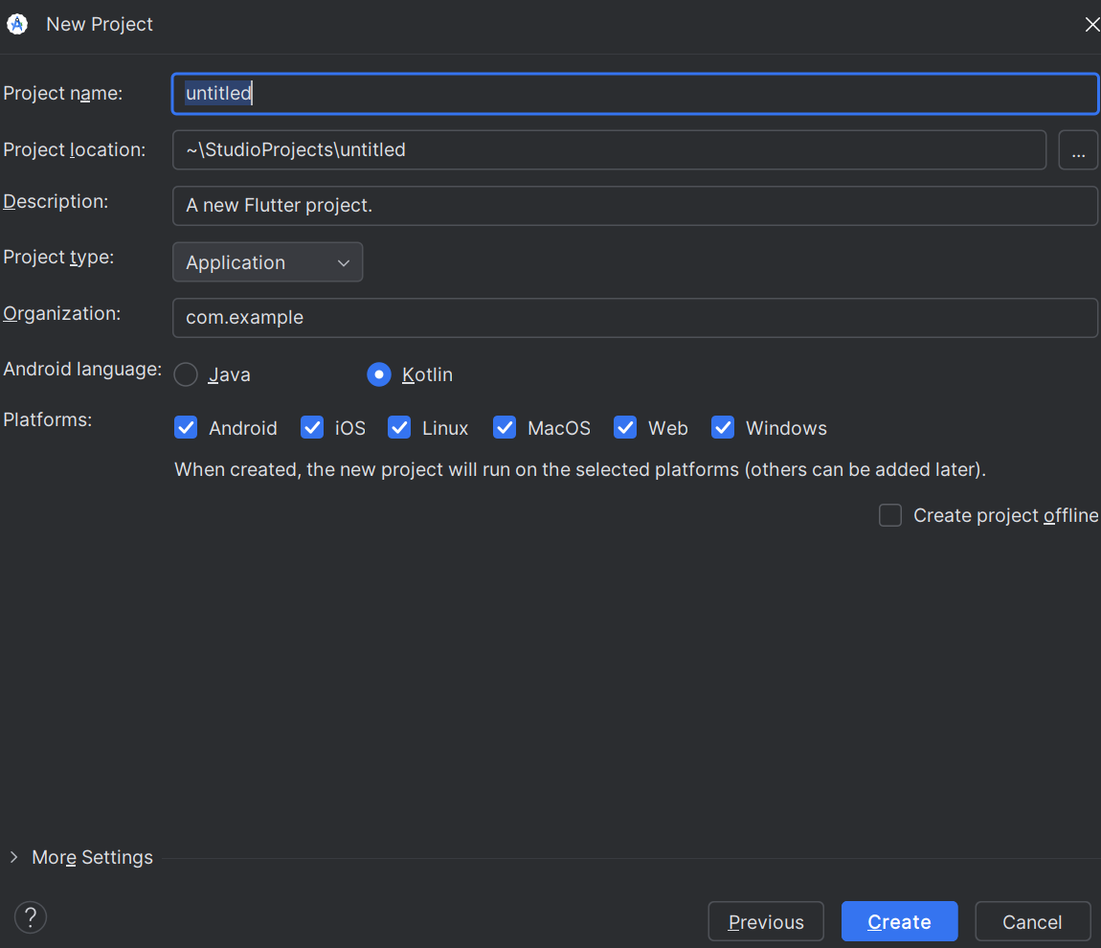
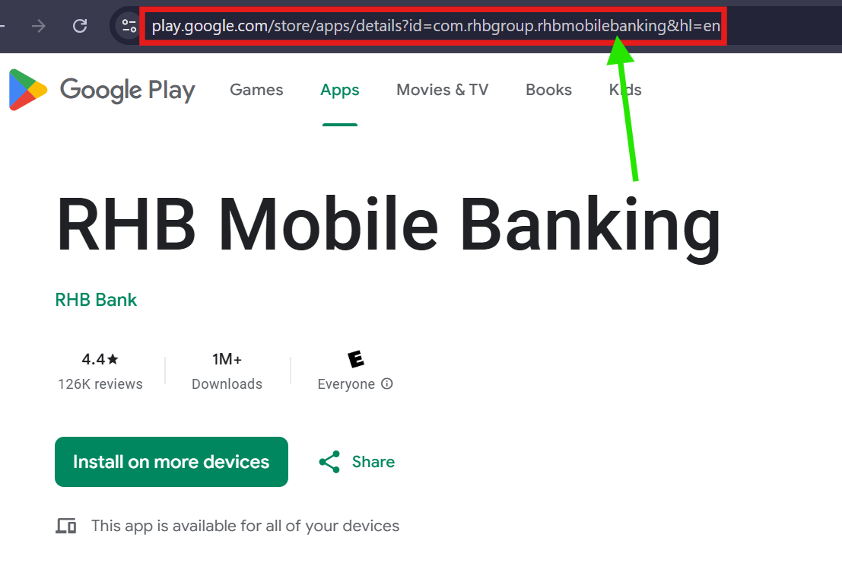
4. Setup an Android Device
Project overview
Organization: com.rhbgroup.rhbmobilebanking
Project name struceture is: com.example.untitled
Page

Slide 16
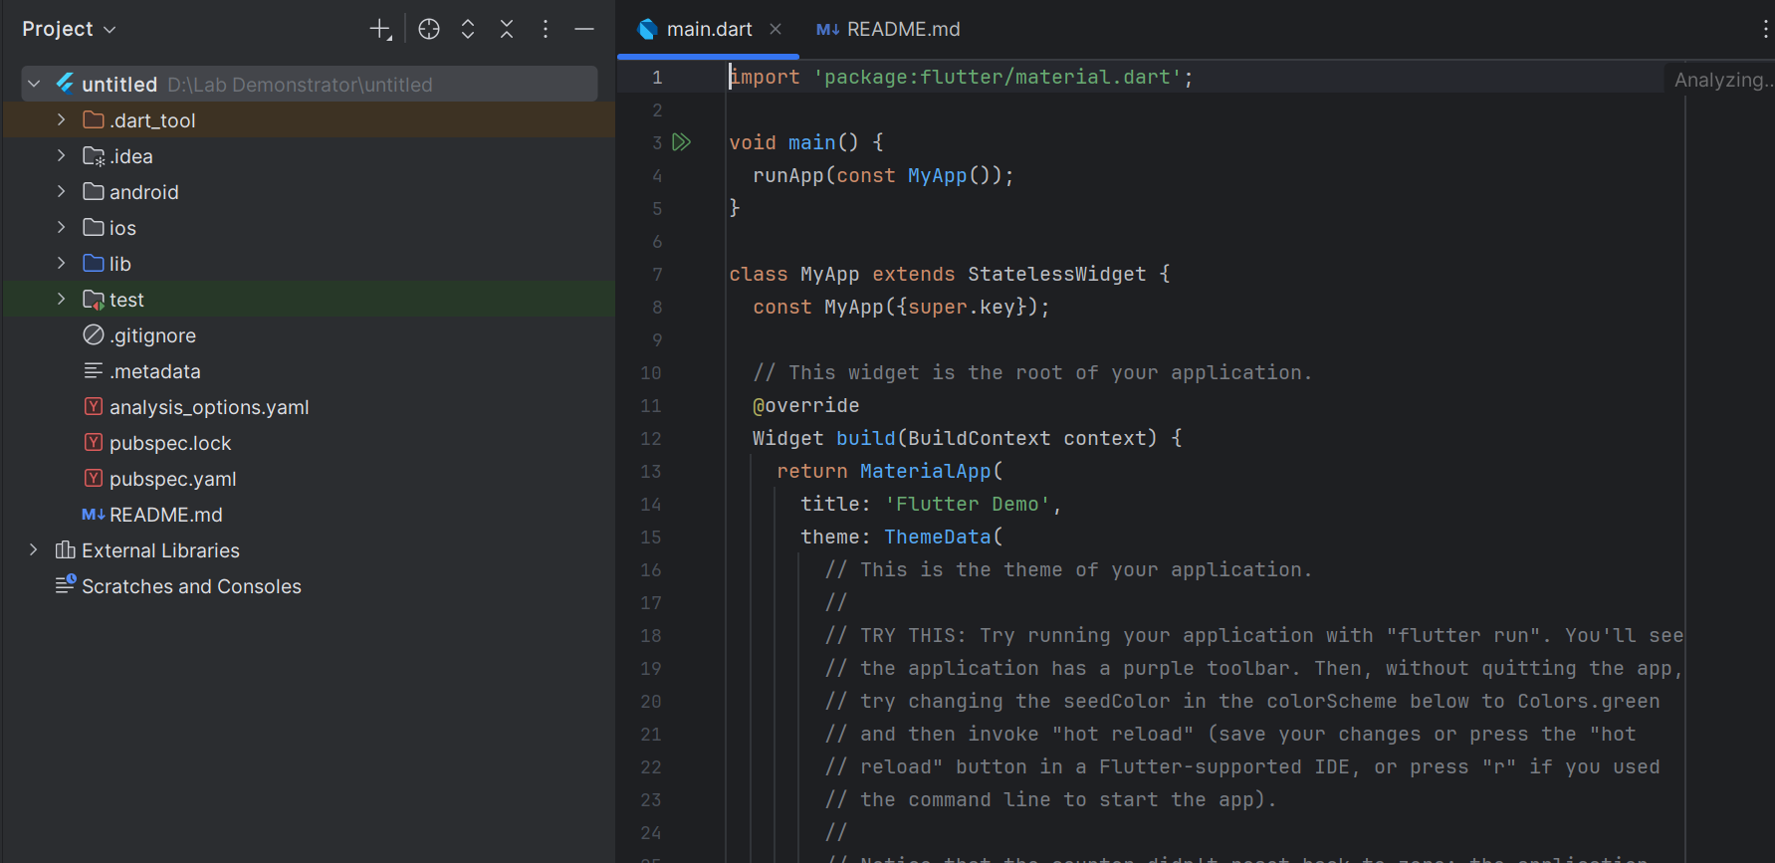
4. Setup an Android Device
Project Setup done
Project name struceture is: com.example.untitled
Page

Slide 17
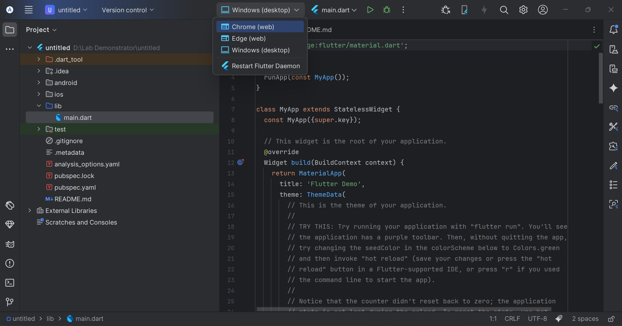
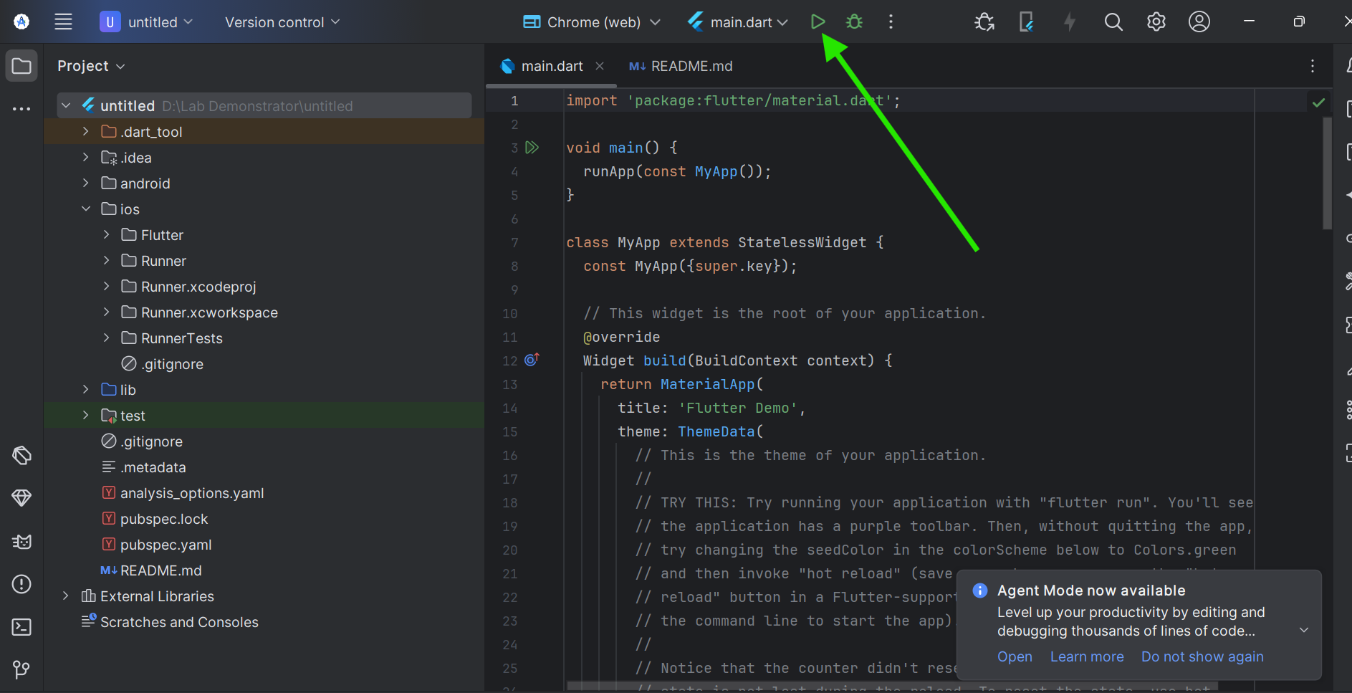
4. Setup an Android Device
You can select the option for run the code, I am using the Chrome web and click run
Page

Slide 18
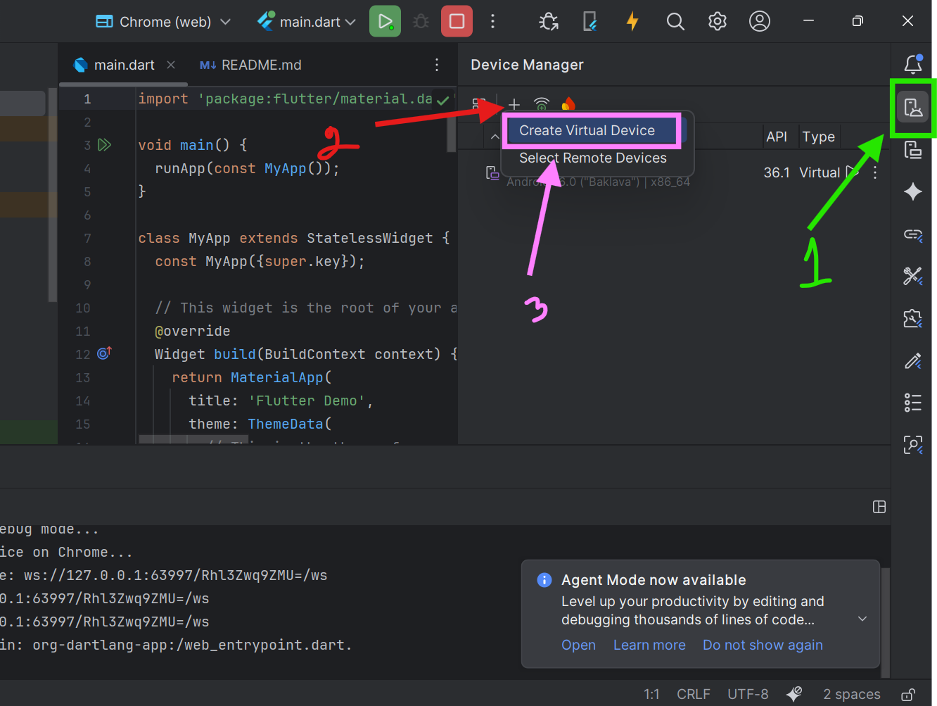
4. Setup an Android Device
Create virtual device for show the output
Step – 01: click device manager
Step – 02: Click Plus icon
Step - 03: Click create virtual device
Step – 04: Select your device and download it
Page

Slide 19
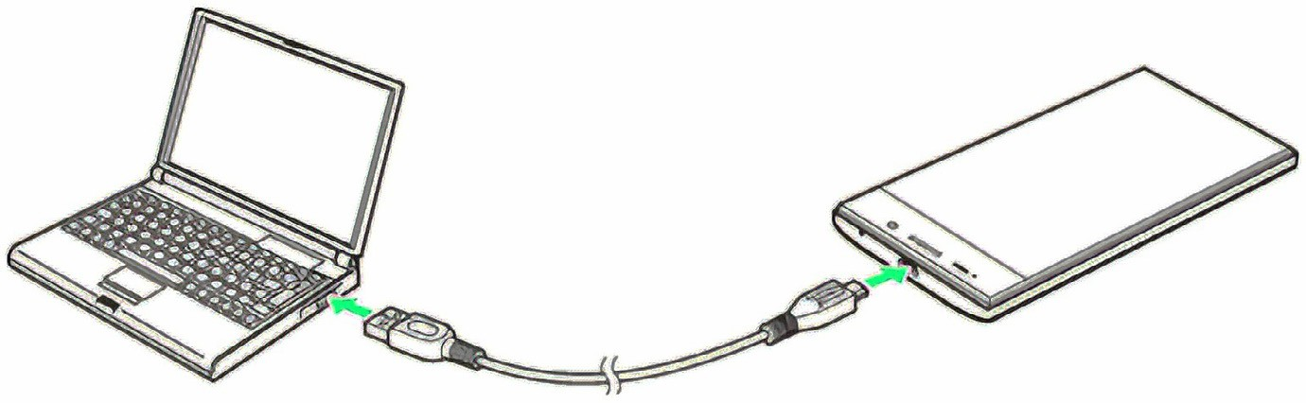
5. Run your Apps on a Hardware Device (Physical Phone)
When building a Flutter app, you can test it using an Android or iPhone emulator.
Testing helps check your app’s UI (User Interface) and workflow before release.
It’s important to test on real devices (Android or iPhone) before publishing to app stores.
Using a physical device reduces the load on your computer’s RAM and CPU, especially useful for low-spec computers.
Emulators may cause issues if your computer has limited hardware performance.
Page

Slide 20
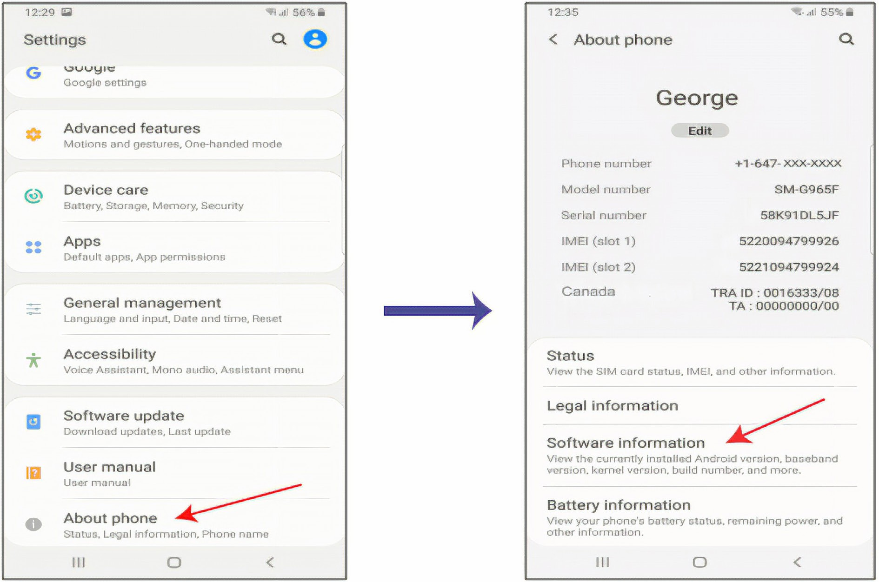
5. Run your Apps on a Hardware Device (Physical Phone)
First need to configure your phone
Go setting and open About Phone, next Software information
Page

Slide 21
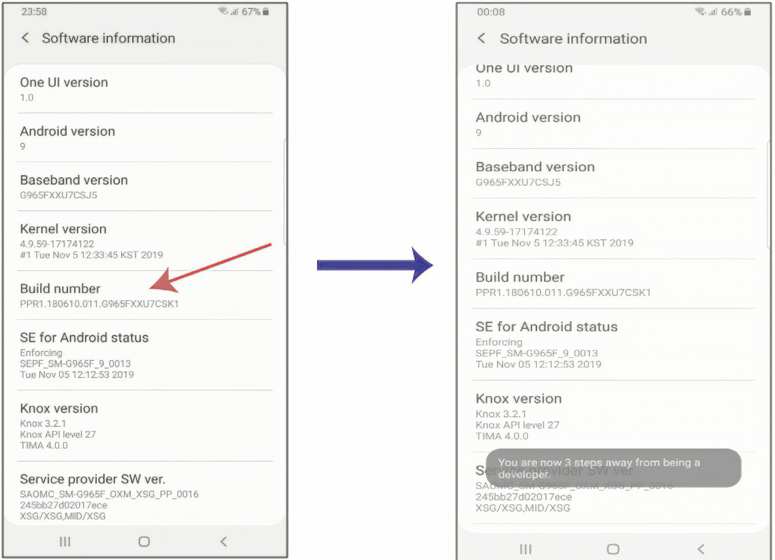
5. Run your Apps on a Hardware Device (Physical Phone)
Press 7 times on the Build number till you get the following message: “ Developer mode has been turned on.” as illustrated in the following figure:
Page

Slide 22
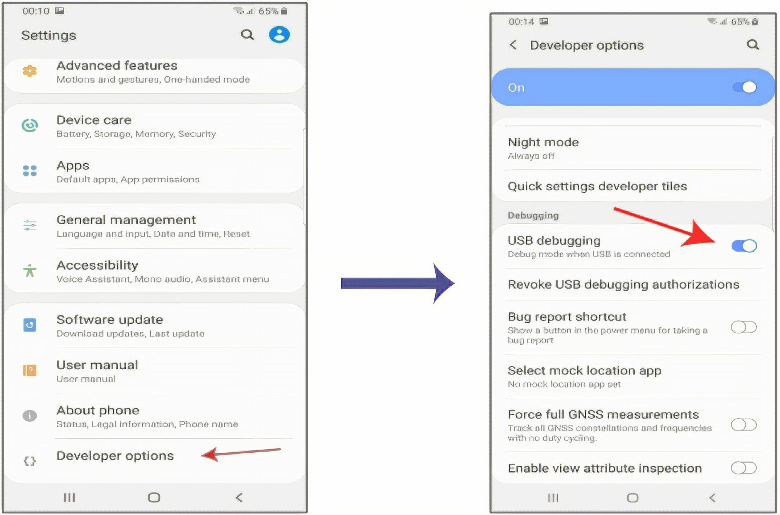
5. Run your Apps on a Hardware Device (Physical Phone)
Go to Settings, then you will find Developer options has been added. Select Developer options. Be sure this option is On. Then enable USB debugging as illustrated in the following figures:
Page

Slide 23
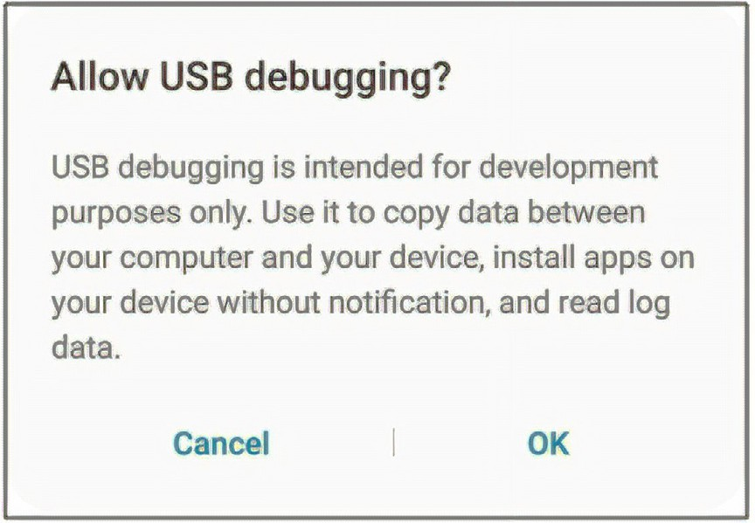
5. Run your Apps on a Hardware Device (Physical Phone)
Select OK for this message: “Allow USB debugging?” as illustrated in the following figure:
Now, your Android phone is ready to be connected to your computer using a USB cable and run your Flutter app. Before following this step, it is important to pay attention to the following note:
Not all USB cables are created equally. Some cables can transfer power without being able to transfer data. So, even if you see your device charging, it doesn’t mean that the cable can transfer the data to allow your phone to be recognized by your computer. Ideally, find the original cable that came with your device. This usually allows both charging as well as data transfer.
Page

Slide 24
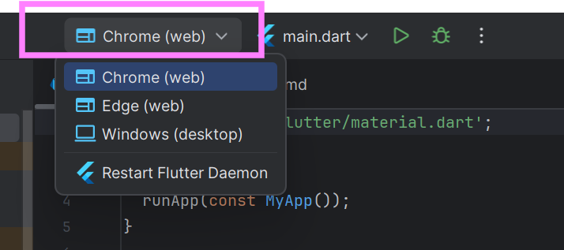
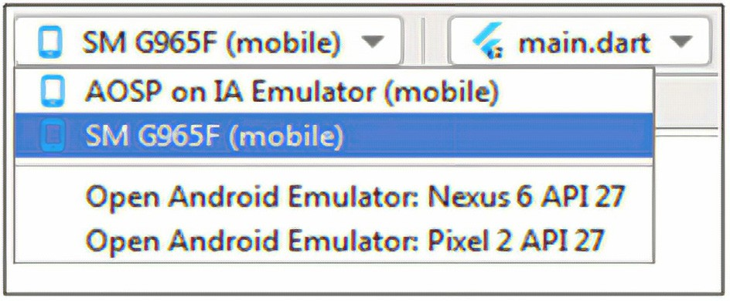
5. Run your Apps on a Hardware Device (Physical Phone)
Click there you will find your device
Page

Slide 25
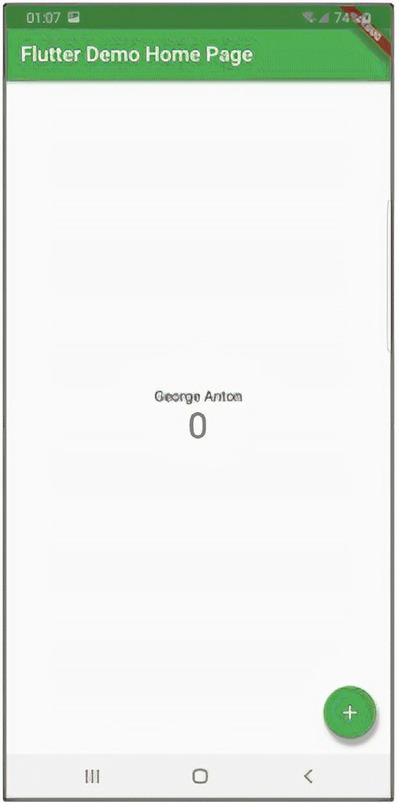
5. Run your Apps on a Hardware Device (Physical Phone)
Click Run on your Android Studio. Then your Flutter app will run on your connected Android phone as illustrated in the following figure:
Page

Slide 26
5. Run your Apps on a Hardware Device (Physical Phone)
Run your Flutter App on IPhone Device
To run your Flutter app on your connected IPhone device, your computer operating system must be Mac. To run your Flutter app on your connected IPhone using Android Studio you should have the following:
An Apple ID.
You must have an Apple ID. So, you must be registered with Apple, at some point give them your email and have a password. This Apple ID, at this step, doesn’t have to be a developer account. It could be any sort of Apple account that may be used to download apps from the App Store.
An IPhone Device
Your Flutter apps are not going to run onto a watch or any other type of Apple device except IPhone or iPad.
Xcode
Xcode is already installed on your Mac computer as a prerequisite to install Flutter. Also, to avoid any issues of incompatibility between your IPhone software version and XCode, always be sure that you have the latest version of Xcode.
Page

Slide 27
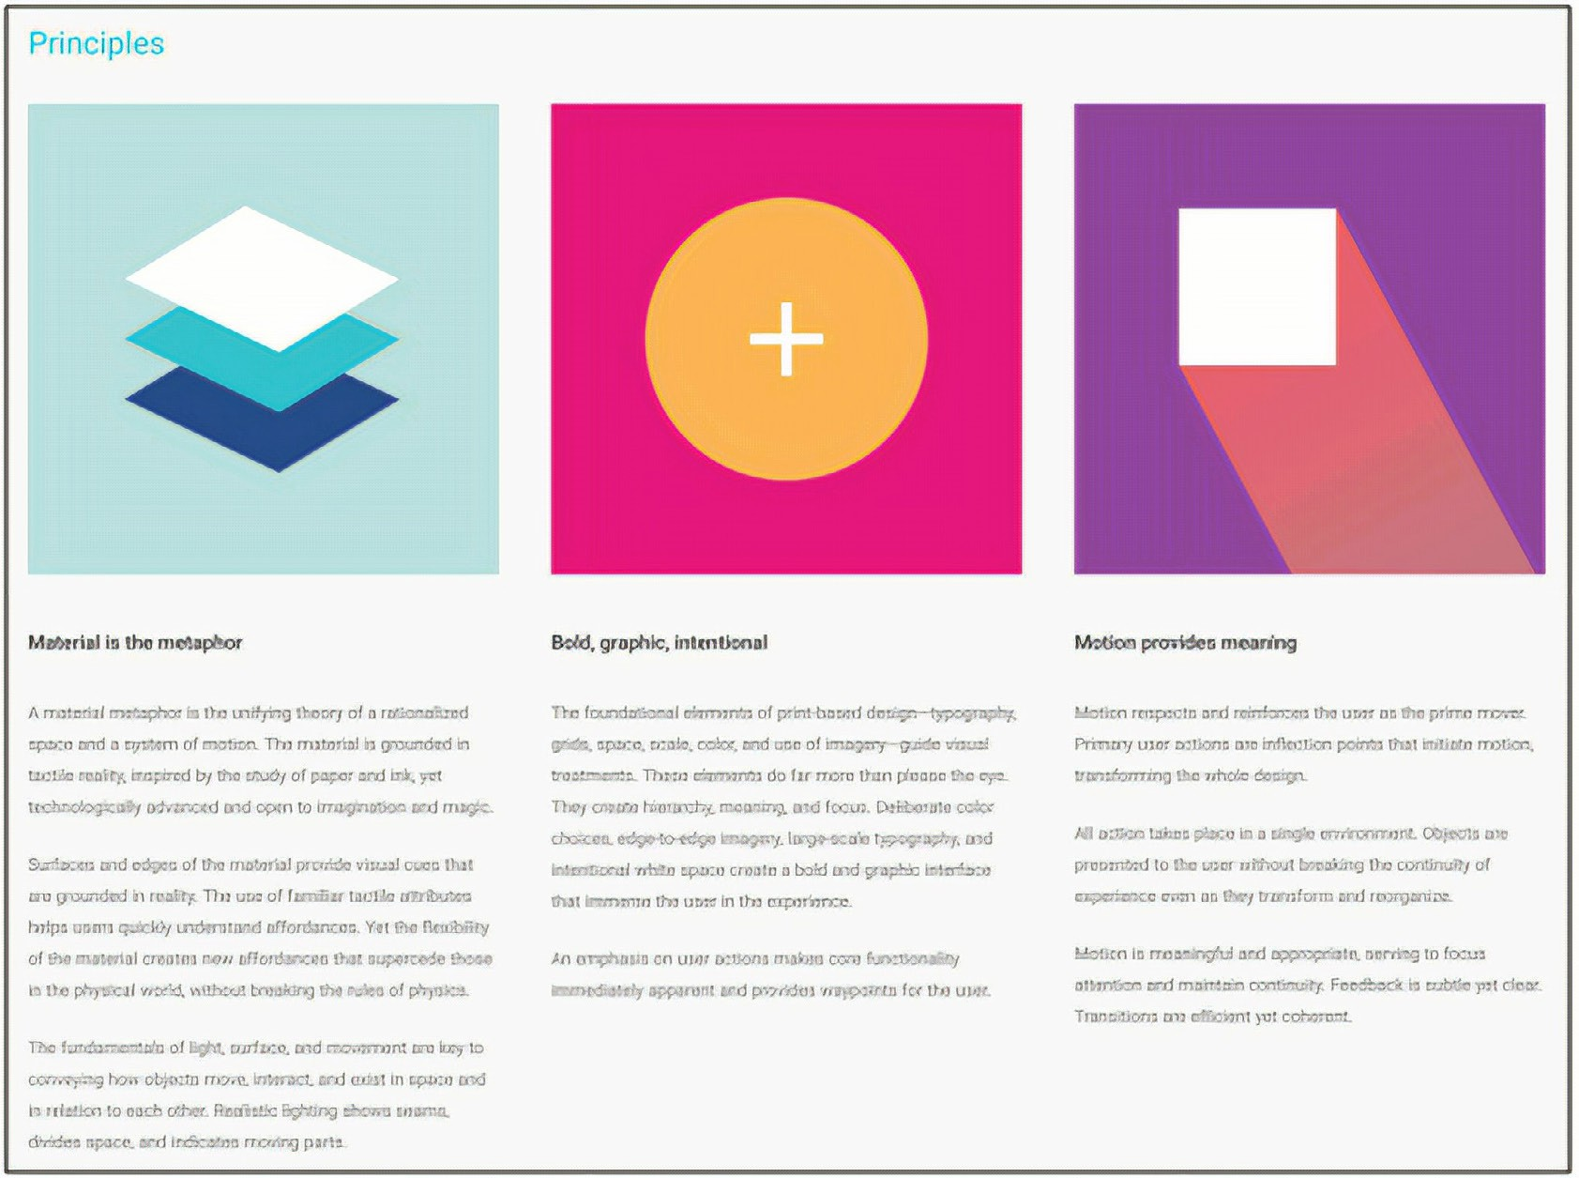
6. Introduction to Flutter Widgets
Flutter builds its UI directly in code, not in XML like other frameworks.
Widgets are the basic building blocks of every Flutter app.
Almost everything in Flutter is a widget —
Text, Image, Icon, Button, Row, Column, etc.
A widget is an immutable object that defines part of your app’s user interface.
You can combine widgets to create more complex layouts.
  Example: Place three Rows inside a Column, and put an Image inside each Row.
Page

Slide 28
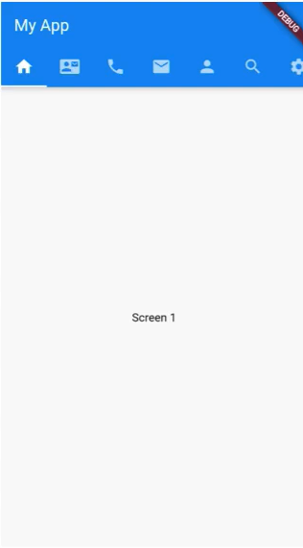
7. What is a MaterialApp widget
What is MaterialApp?
The starting point of every Flutter app.
Tells Flutter to use Material Design — Google’s standard for clean, modern UI.
Acts as the root that contains all other widgets in your app.
Why It’s Important
Provides structure for your app:
  AppBar → top navigation bar
  Scaffold → main page layout
  Body → where your content goes
  BottomNavigationBar, FloatingActionButton, etc.
Makes your app look modern and consistent on both Android and iOS.
Page

Slide 29
Any Questions?

Slide 30
Thank you

